Slide 1
OSGi Training
Christian Schneider
Open Source Architect
cschneider@talend.com

Slide 2
Agenda
OSGi basics
Blueprint (Dependency Injection)
Pax Exam (Integration Tests)
Apache CXF (Web Services and Rest Resources)
Apache Camel (Integration)
JPA

Slide 3
Prerequisites
Apache Karaf 2.3.5
Eclipse Luna
Apache Maven 3.0.x
Training templates

Slide 4
What is OSGi ?
OSGi : OpenSoftware Gateway initiative
OSGi is a dynamic and modular platform for Java, created in 1999 by IBM, Oracle, Sun, Ericson, etc. It's the OSGi Alliance and OSGi Expert Group.

Slide 5
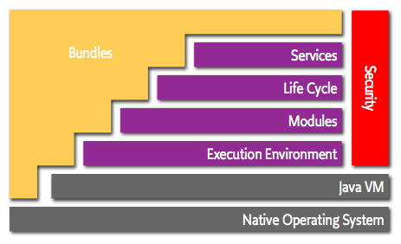
OSGi Architecture

Slide 6
Execution Environment (Framework)
OSGi framework
Runtime kernel that allows to run bundles
Bundles can be managed at runtime

Slide 7
Modules (Bundle)
Bundle
Jar with additional meta data
Classes are resolved on package level not on bundle level
Bundles have to explicitly specify the packages they need and offer. Everything else is private
Bundle­-Version: 1.1.0
Bundle-­SymbolicName: org.myorg.mybundle
Export-Package: org.myorg.mypackage;version=1.0
Import-­Package: org.other.package;version=[1.0;1.5)
Bundle­-Activator: org.myorg.Activator
Version and Name are unique in the framework

Slide 8
Modules (Class loading)
Each bundle has its own class loader
java.* and packages specified in boot delegation resolved from Parent classloader (Framework classloader)
For each Import-Package the bundle classloader delegates to the classloader of the bound bundle that exports the package
All other packages resolved internally from bundle
Parent Classloader
java.*,
boot delegation packages
Bundle A Classloader
Bundle B Classloader
org.other.package.*

Slide 9
Modules (Classloading 2)
The classloader of a class is the (delegated) classloader that ultimately loaded the class
Example: Class A from Bundle BundleA
Class B from Bundle BundleB
Code inside class A: this.getClass().getClassloader() -> Classloader of Bundle A B b = new B(); b.getClass().getClassloader() -> Classloader of Bundle B

Slide 10
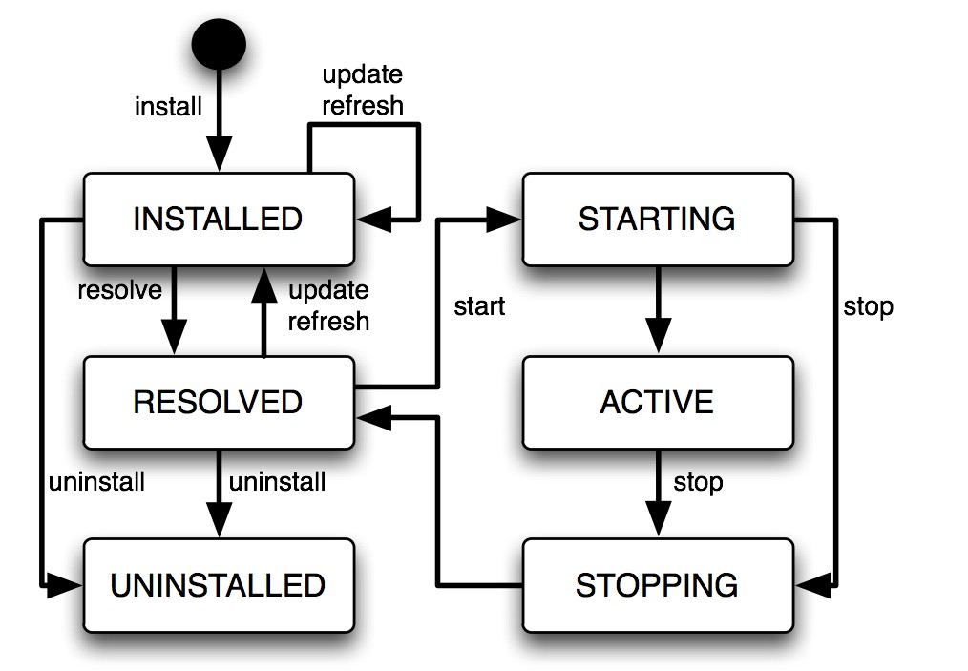
Lifecycle
Reflects dynamic nature of OSGi
Resolve: Imported packages are bound to bundles that export them
Start: Activator start method is called
Stop: Activator stop method is called

Slide 11
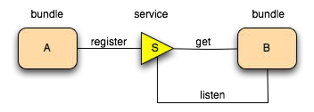
Services
OSGi Service: Java object instance + Properties
Bundles can register / unregister services at runtime
Bundles can listen to service lifecycle -> ServiceReference
Service object retrieved using context.getService(reference)
Calls on service objects are pure java method calls. No magic
Never hold service objects over longer periods. Unget after use

Slide 12
Apache Karaf, Blueprint and OSGi services
See apachecon talk https://docs.google.com/presentation/d/1xa5XWWJ40X_WYb8MiDbRGtHx20f4CfXHfi7cg4RHahk/edit

Slide 13
Organizations and Projects
Apache
Felix -> OSGi Framework and impls to OSGi specs
Maven bundle plugin -> uses bnd to create bundles
Karaf -> OSGi Server
Aries -> impls to OSGi specs
Blueprint
JPA
JNDI
Eclipse
Equinox -> OSGi Framework
Other OSGi spec impls
OPS4J
Pax Project -> OSGi tools
Pax Web
Pax Exam
OSGi Alliance
Bnd -> Tool to create Manifests for bundles

